Slide 1
Lesson_2: Structuring an HTML Document
Prof:Ronak Sheth

Slide 3
Sample code
<!doctype html> <html lang="en"> <head> <meta charset="utf-8"> <title> The First Web Page </title> </head> <body> <p> In the beginning, Tim created the HyperText Markup Language. The Internet was without form and void, and text was upon the face of the monitor and the Hands of Tim were moving over the face of the keyboard. And Tim said, Let there be links; and there were links. And Tim saw that the links were good; and Tim separated the links from the text. Tim called the links Anchors, and the text He called Other Stuff. And the whole thing together was the first Web Page. </p> </body> </html>

Slide 4
the words starting with < and ending with > are actually coded commands.
These coded commands are called HTML tags because they “tag” pieces of text and tell the web browser what kind of text it is
This allows the web browser to display the text appropriately. HTML tags can be written in uppercase, lowercase, or a combination of both. But best practices say you should use all lowercase letters for your tags

Slide 5
An opening tag is an HTML tag that indicates the start of an HTML command; the text affected by the command appears after the opening tag. Opening tags always begin with < and end with >, as in <html>.
A closing tag is an HTML tag that indicates the end of an HTML command; the text affected by the command appears before the closing tag. Closing tags always begin with </ and end with >, as in </html>.
For example, the <body> tag tells the web browser where the actual body content of the page begins, and </body> indicates where it ends. Everything between the <body> and </body> tags appears in the main display area of the web browser window,
The very top of the browser window shows title text, which is any text that is located between <title> and </title>. The title text also identifies the page on the browser’s Bookmarks or Favorites menu, depending on which browser you use. It’s important to provide titles for your pages so that visitors to the page can properly bookmark them for future reference; search engines also use titles to provide links to search results.

Slide 6
Organizing a Page with Paragraphs and Line Breaks
p tag
br tag
Hr tag
<!doctype html> <html lang="en"> <head> <meta charset="utf-8"> <title>My Widgets</title> </head> <body> <h1>My Widgets</h1> <p>My widgets are the best in the land. Continue reading to learn more about my widgets.</p> <h2>Widget Features</h2> <p>If I had any features to discuss, you can bet I'd do it here.</p> <h3>Pricing</h3> <p>Here, I would talk about my widget pricing.</p> <h3>Comparisons</h3> <p>Here, I would talk about how my widgets compare to my competitor's widgets.</p> </body> </html>

Slide 7
Heading tags
H1,h2,h3…h5

Slide 8
semantic elements
Please refer to html doc attached here

Slide 9
Tag | Function
<html>…</html> | Encloses the entire HTML document.
<head>…</head> | Encloses the head of the HTML document. Used within the <html> tag pair.
<meta charset="utf-8"> | Defines the character set for the document as UTF-8. Used within the <head> tag pair, immediately after the opening <head> tag.
<title>…</title> | Indicates the title of the document. Used within the <head> tag pair.
<body>…</body> | Encloses the body of the HTML document. Used within the <html> tag pair.
<p>…</p> | Encloses a paragraph; skips a line between paragraphs.
<br> | Indicates a line break.
<hr> | Displays a horizontal rule.
<h1>…</h1> | Encloses a first-level heading.
<h2>…</h2> | Encloses a second-level heading.
<h3>…</h3> | Encloses a third-level heading.
<h4>…</h4> | Encloses a fourth-level heading (seldom used).
<h5>…</h5> | Encloses a fifth-level heading (seldom used).
<h6>…</h6> | Encloses a sixth-level heading (seldom used).
<header>…</header> | Contains introductory information.
<footer>…</footer> | Contains supplementary material for its containing element (commonly a copyright notice or author information).
<nav>…</nav> | Contains navigational elements.
<section>…</section> | Contains thematically similar content, such as a chapter of a book or a section of a page.
<article>…</article> | Contains content that is a standalone body of work, such as a news article.
<aside>…</aside> | Contains secondary information for its containing element.
<address>…</address> | Contains address information related to its nearest <article> or <body> element, often contained within a <footer> element.

Slide 12
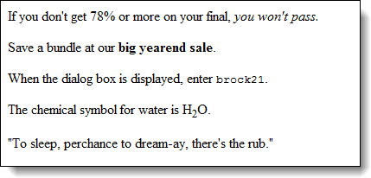

Slide 16
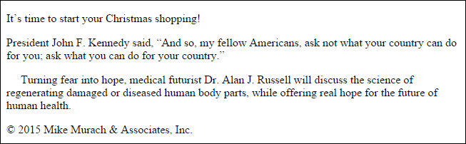

Slide 19
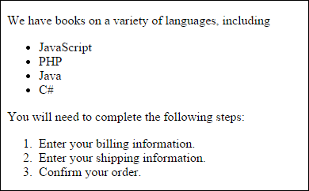

Slide 20
Img tag and a href tag
<header> <img src="acmewidgets.jpg" alt="ACME Widgets LLC"> <h1>The finest widgets are made here!</h1> <nav> <ul> <li><a href="#">About Us</a></li> <li><a href="#">Products</a></li> <li><a href="#">Support</a></li> <li><a href="#">Press</a></li> </ul> </nav> </header>

Slide 21
<footer> <p>&copy; 2014-2018 Acme Widgets, LLC. All Rights Reserved.</p> <p>Copyright Issues? Contact:</p> <address> Our Lawyer<br> 123 Main Street<br> Somewhere, CA 95128<br> <a href="mailto:lawyer@richperson.com">lawyer@richperson.com</a> </address> </footer>

Slide 24


